Slide 1
MoMA Artistic Style Network
Aydin Wells & Zachary Rex
PHYS 5116 Final Presentation

Slide 2
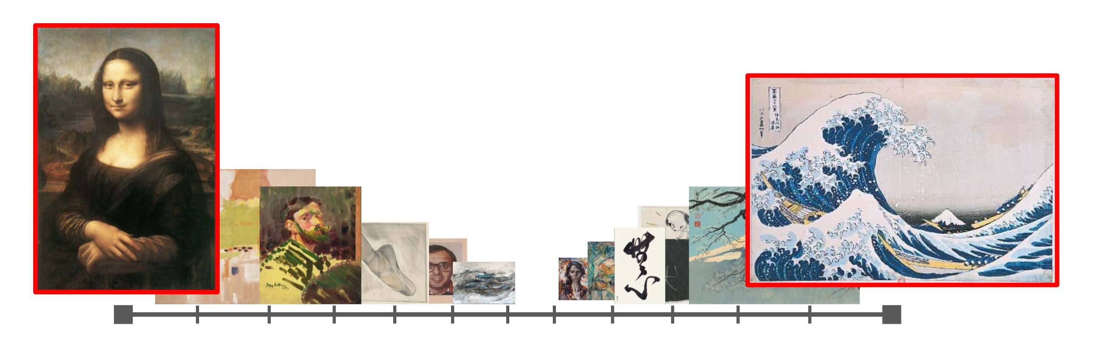
Goal
The goal of this study is to elucidate and understand interactions between each MoMA artist and artwork by means of latent feature extraction and dissimilarity analyses

Slide 3
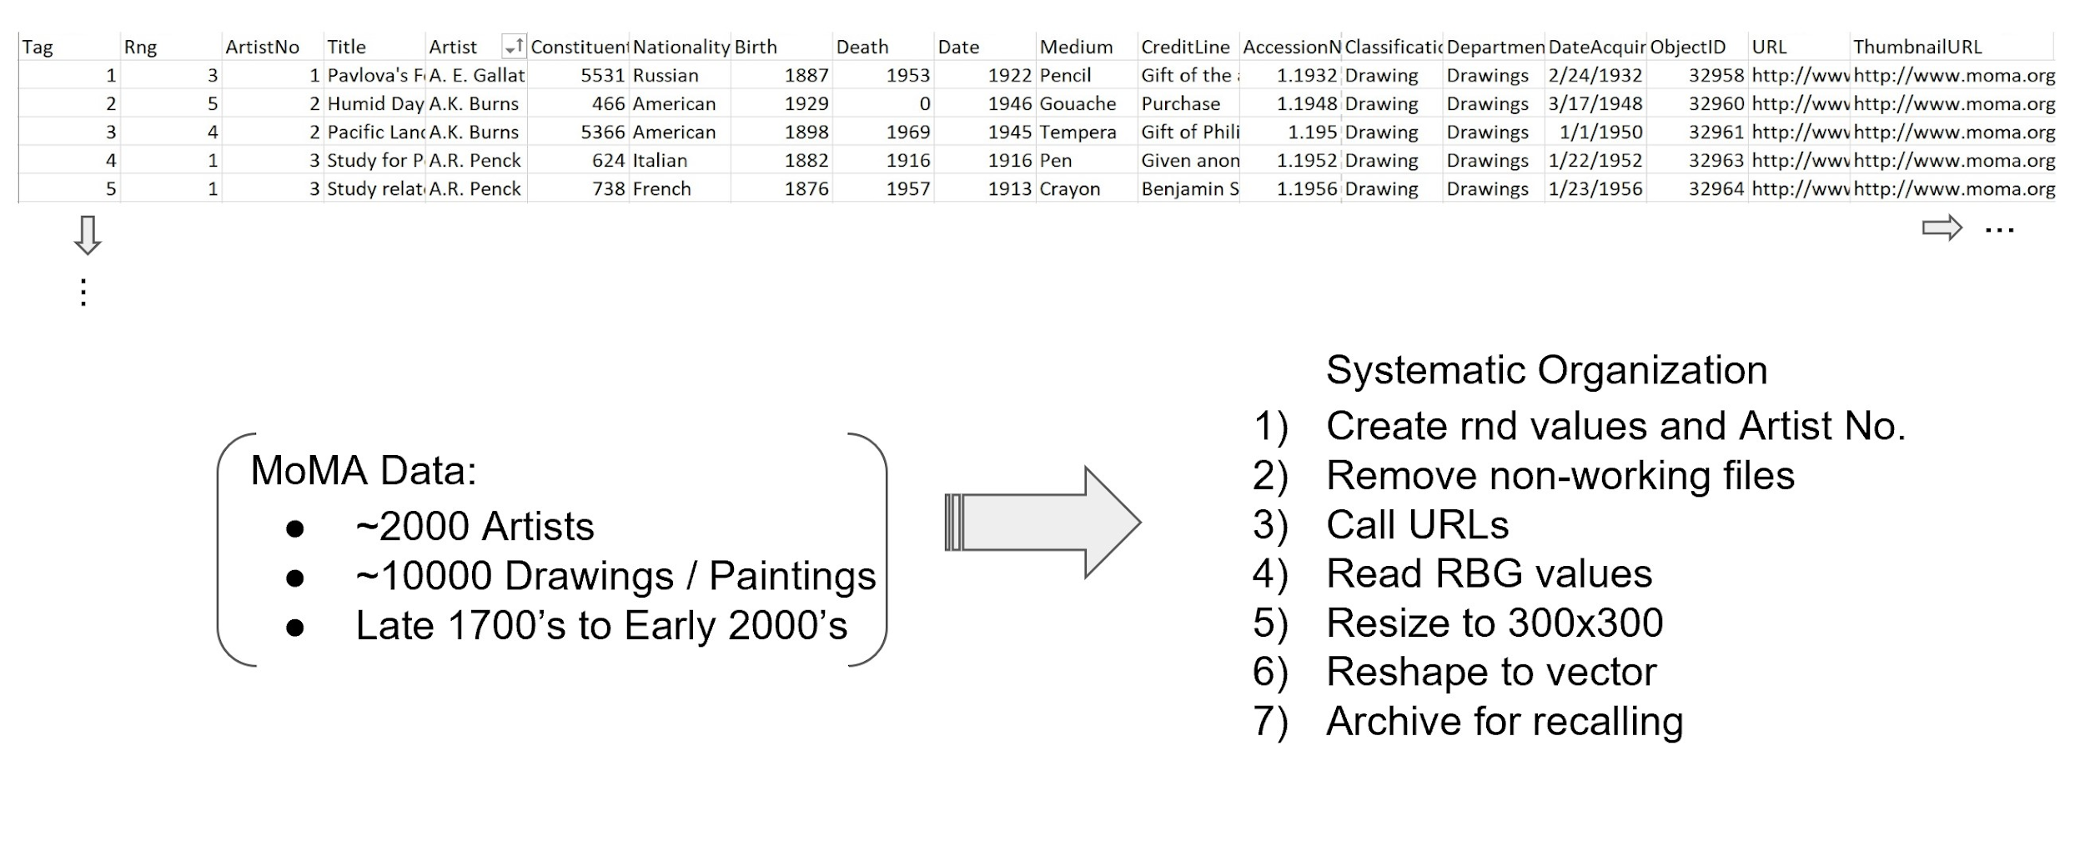
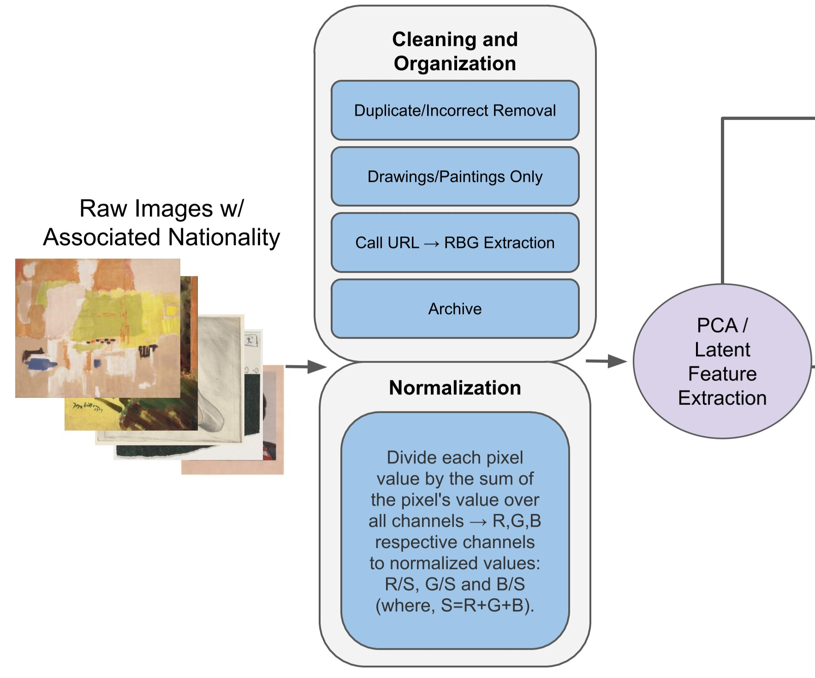
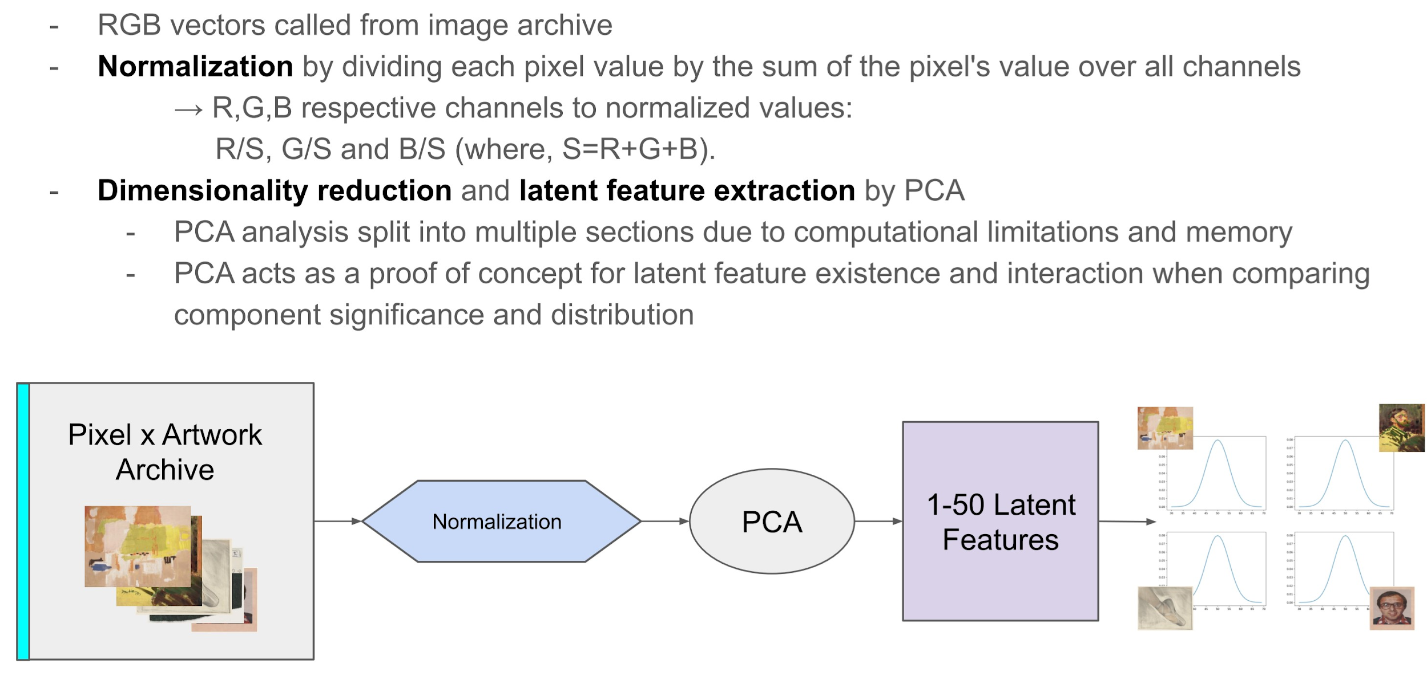
Data and Image Analysis
https://www.moma.org/collection/

Slide 4
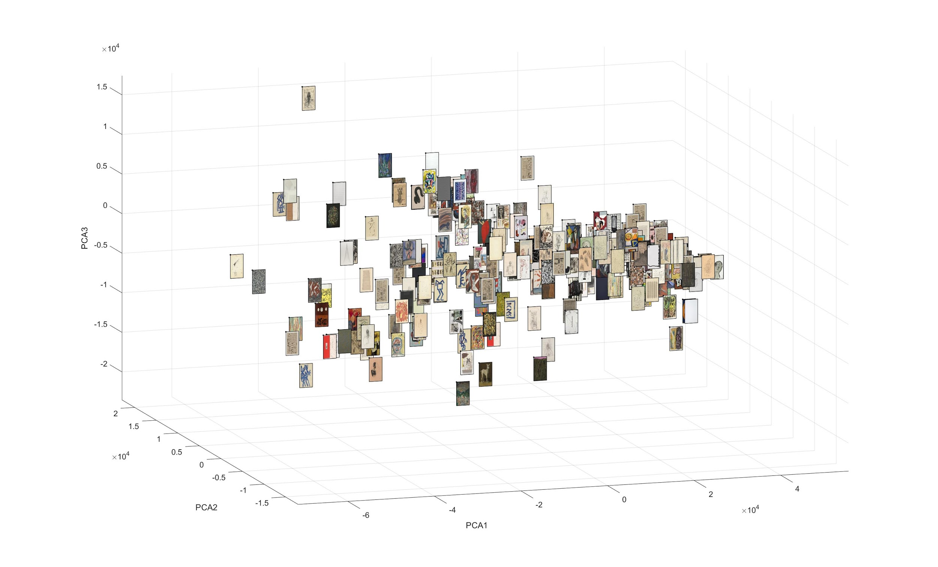
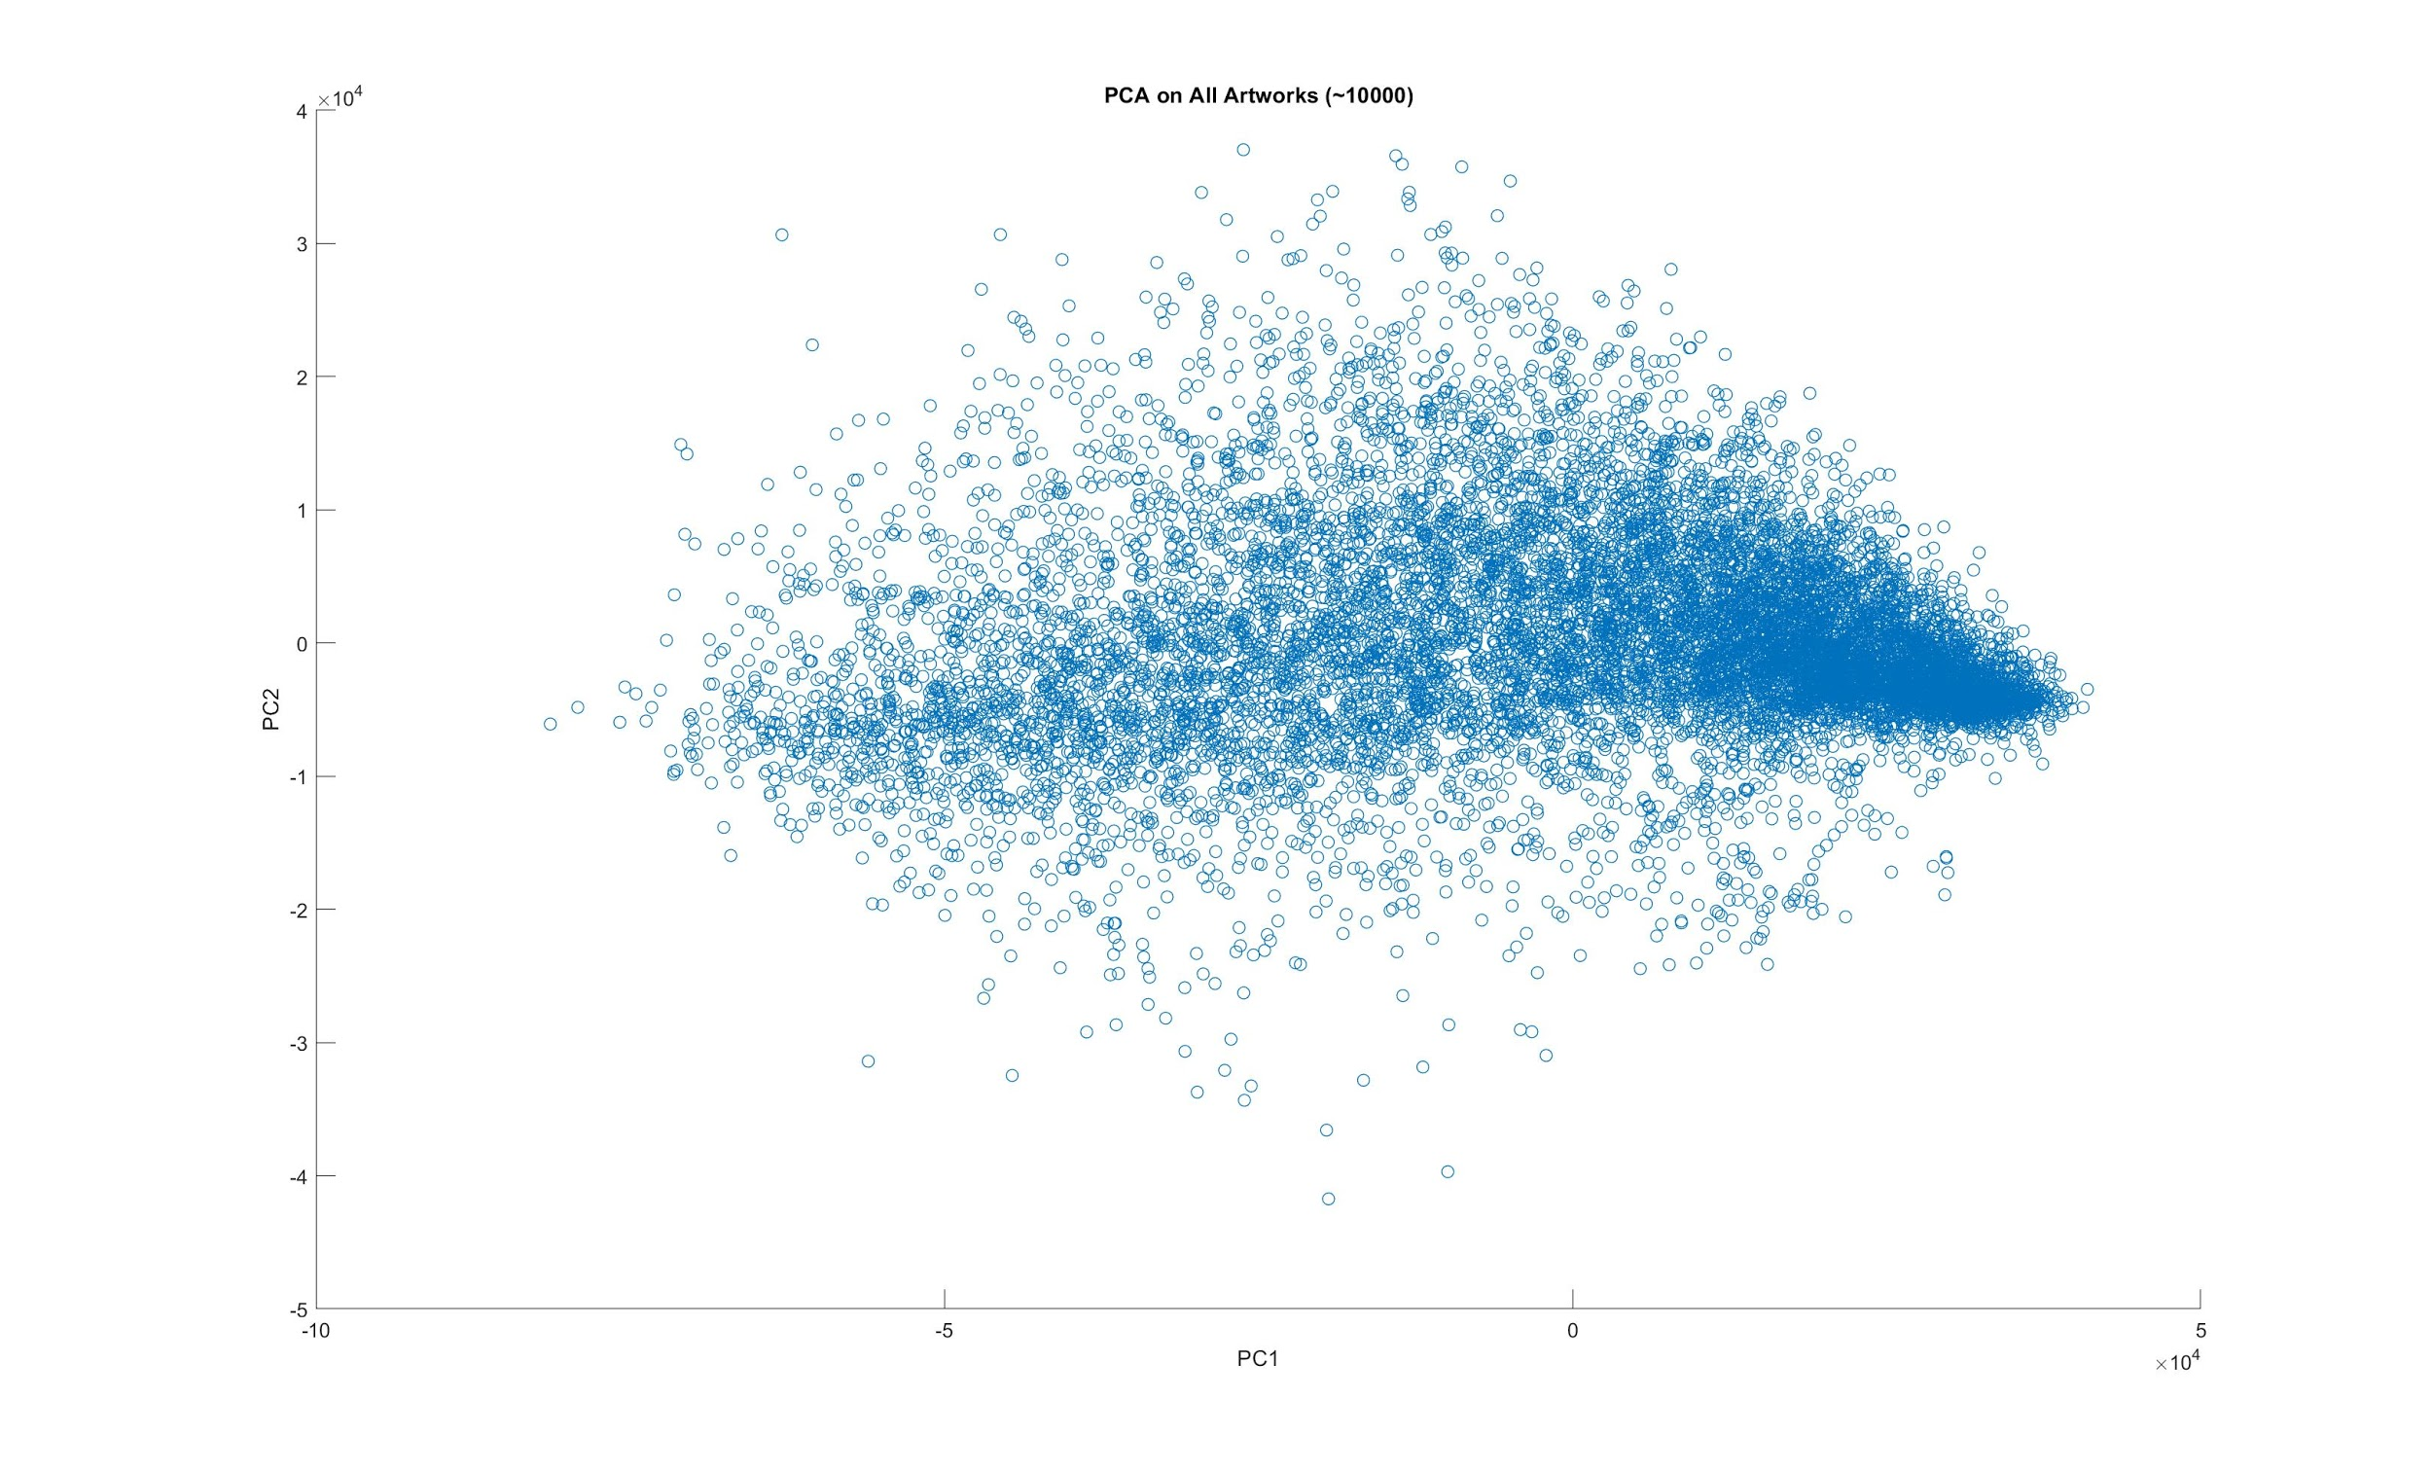
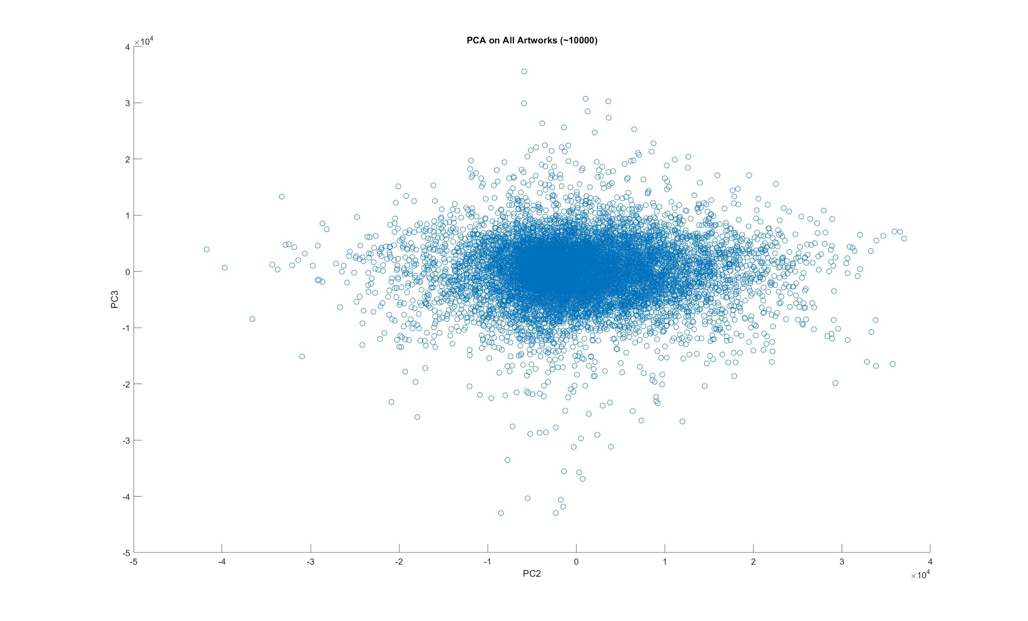
PCA

Slide 5
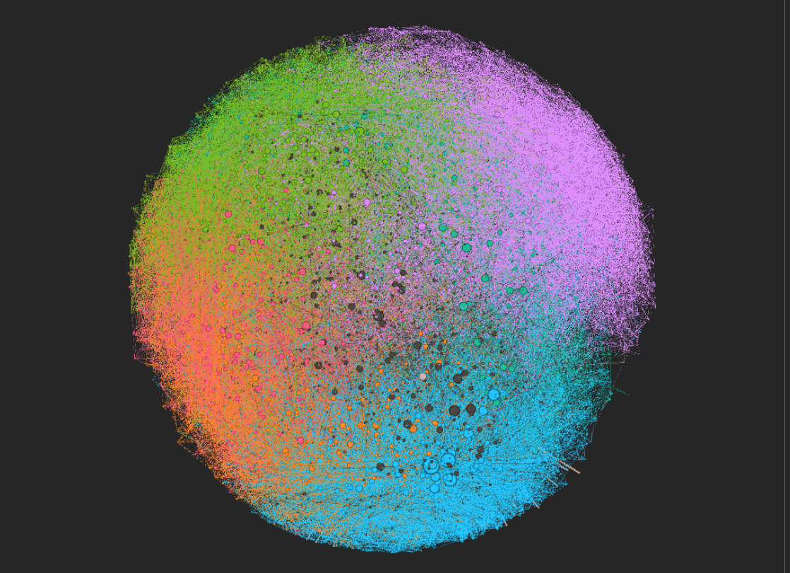
Artwork Network
Undirected Network:
10490 nodes (artworks)
93221 links (similar features)
Euclidean distance
Significant feature effectors

Slide 6
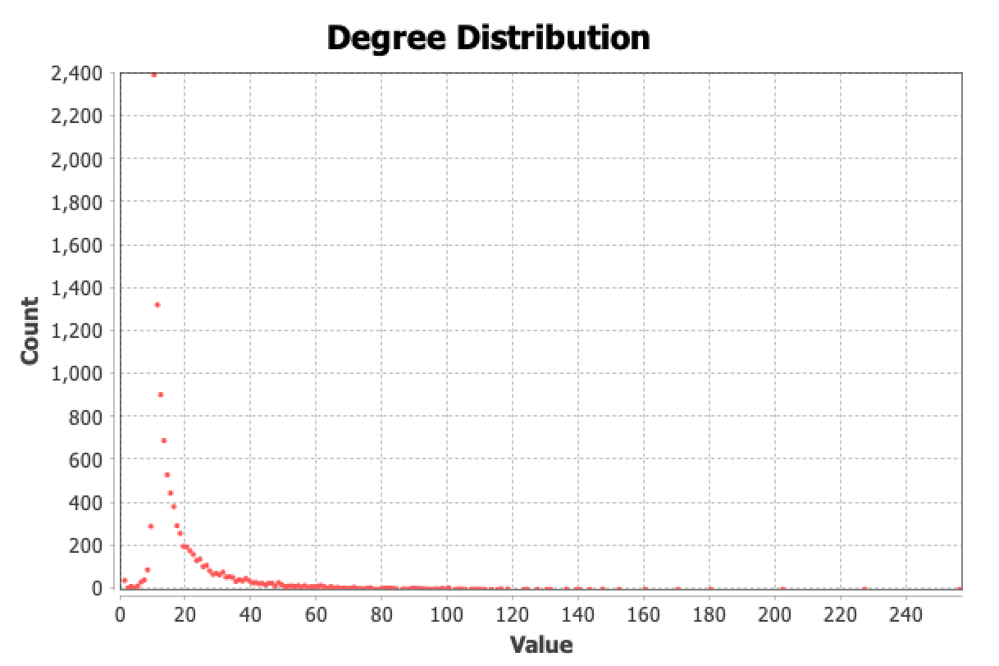
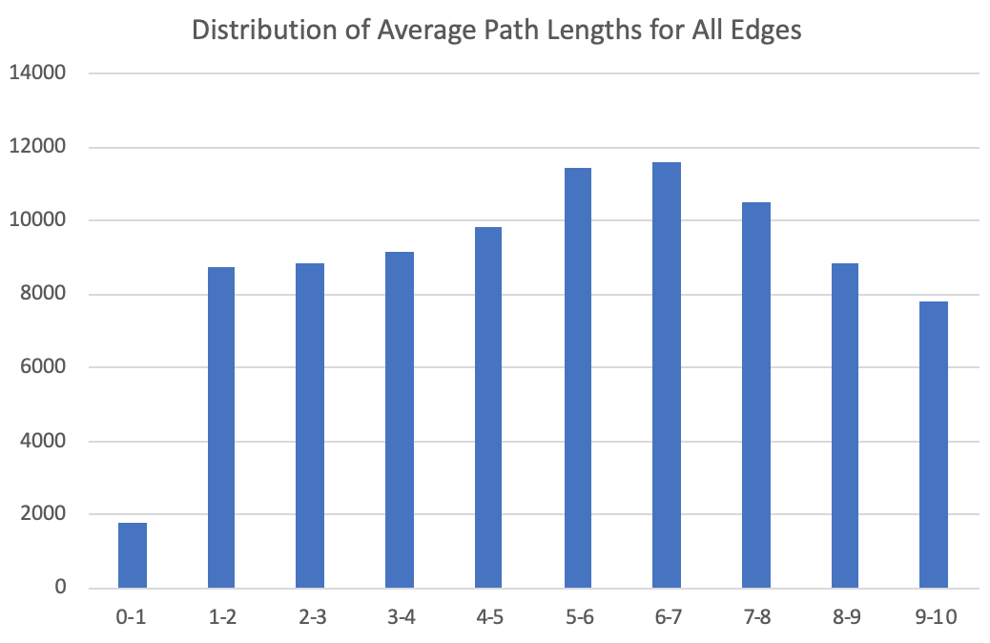
Network Measurements
Probability Distribution
Average Degree <k>: 17.773
Size/Dimension Measures:
Diameter: 10
Average Path length: 4.872

Slide 7
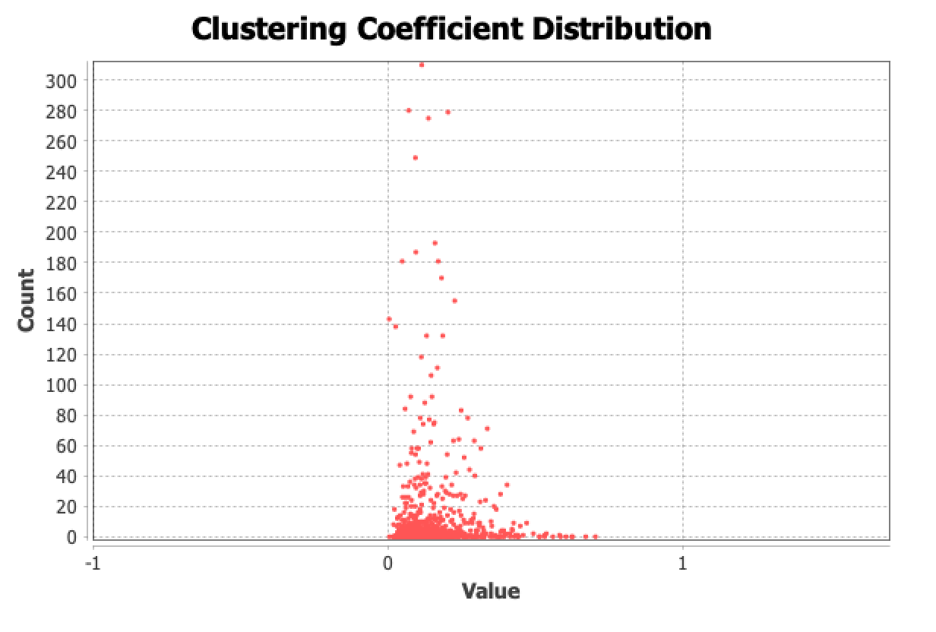
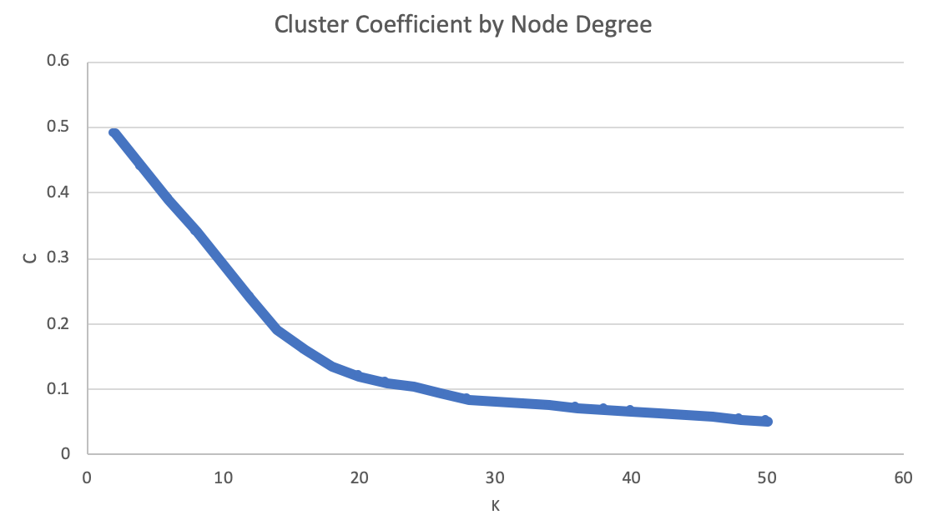
Network Measurements (cont.)
Clustering Coefficient
<C> = 0.134

Slide 8
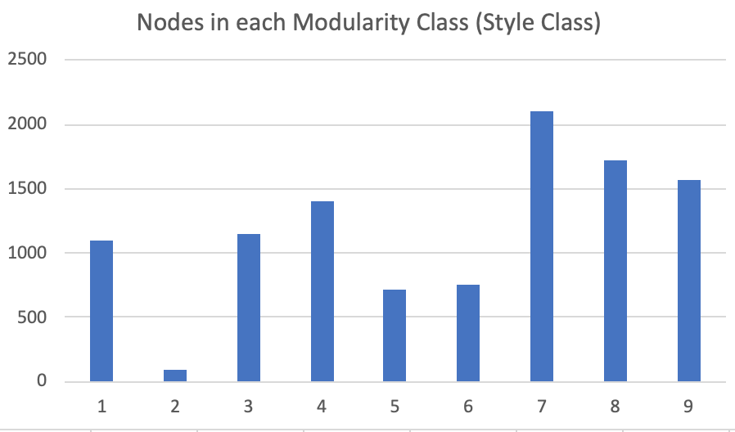
Network Measurements (cont.)
Modularity
Modularity of entire network, M = 0.643
Indicates strong community structure among arbitrary style classes

Slide 9

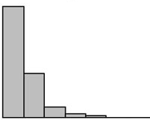
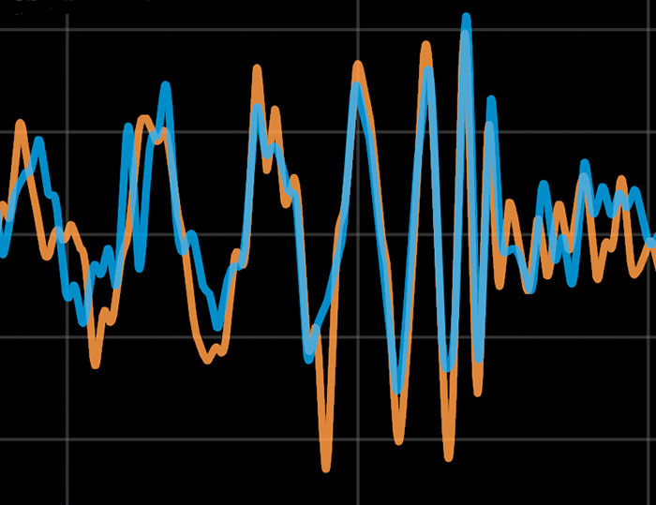
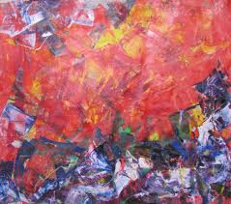
Augmentations
After latent Feature Extraction (via PCA):
Discrete Logarithmic Probability Distribution Generation
Distribution Combination (Profiling)
KL-Divergence
Signal Similarity Measure

Slide 10
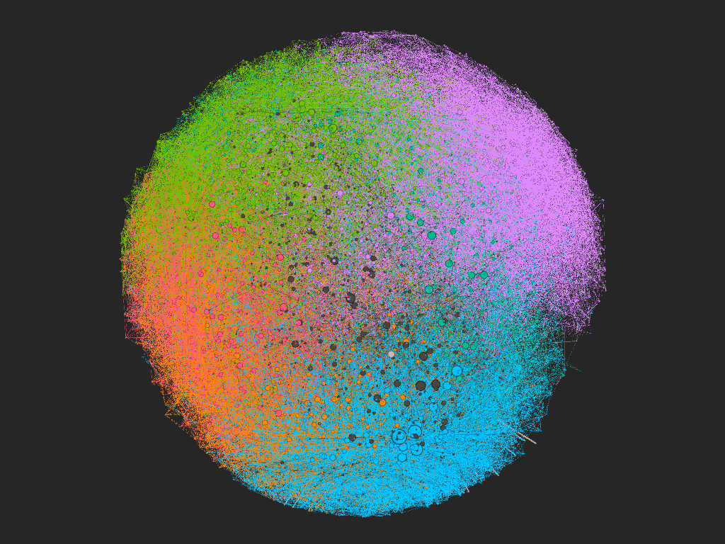
(made in Gephi)

Slide 11
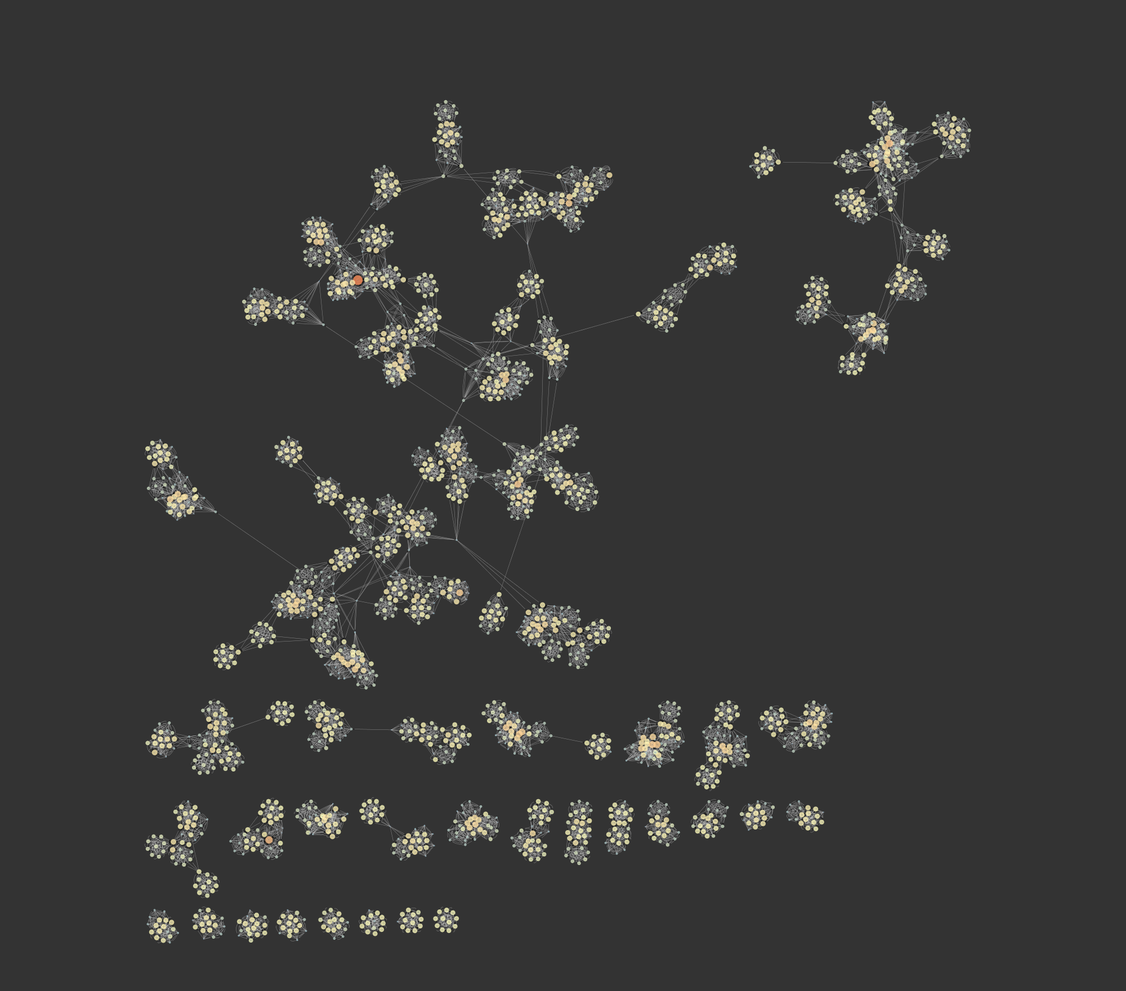
(made in Cytoscape)

Slide 12
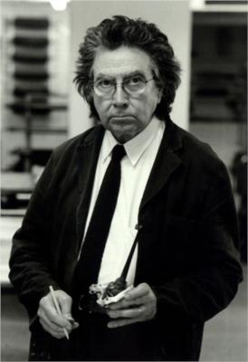
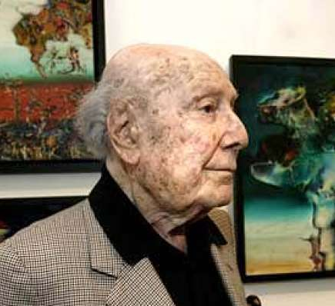
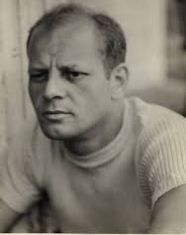
Artist Network
Directed/Rewiring Network:
2206 nodes (artists)
19069 links (similar features)
Ideal-model identification
Artist to artwork combination
Similarity measure

Slide 13
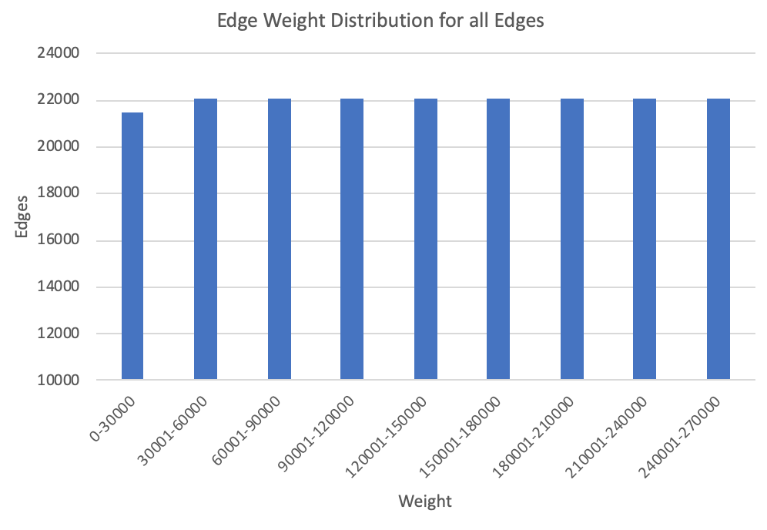
Network Measurements
Size/Dimension Measures:
Diameter: 9
Average Path length: 4.872
Average Degree <k>: 9.916
Modularity: 0.938
<C> = 0.615

Slide 14
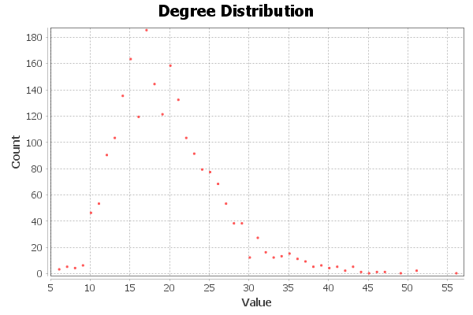
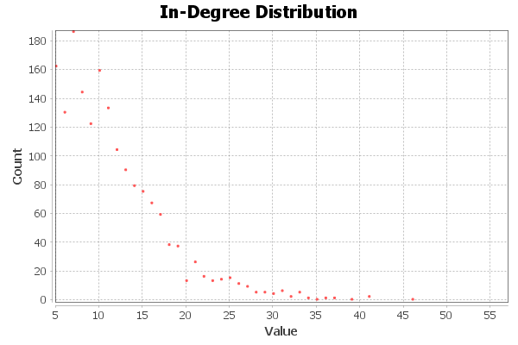
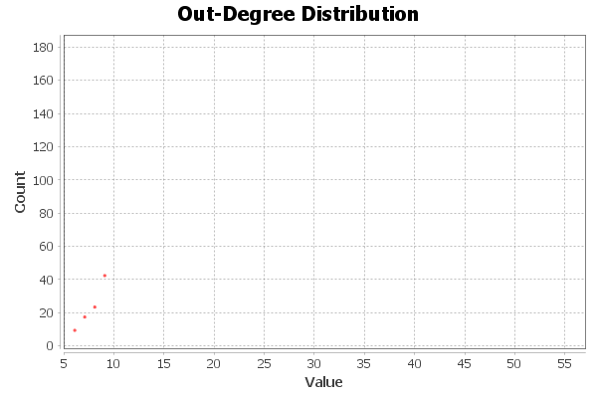
Network Measurements (cont)

Slide 15
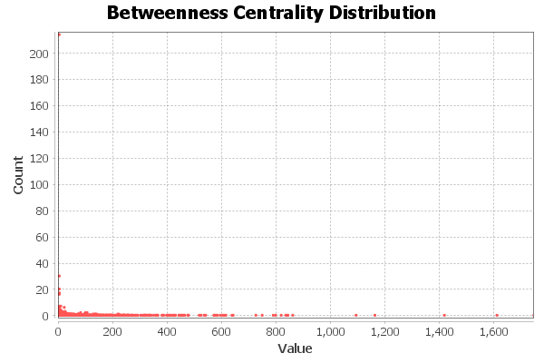
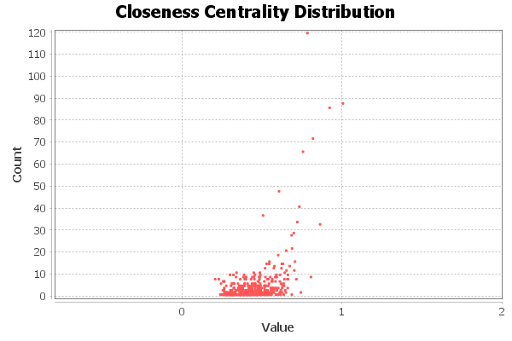
Network Measurements (cont)

Slide 16
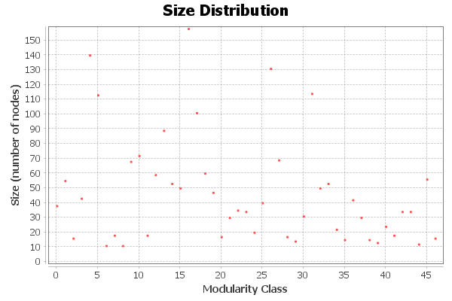
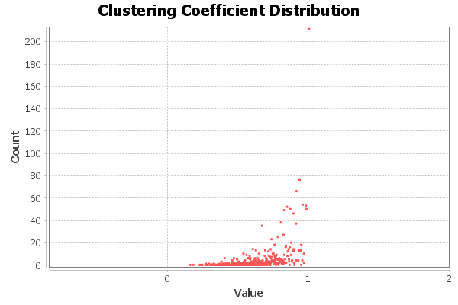
Network Measurements (cont)

